Slide 1
Yelp Review Analysis
for
Mexican Restaurant
STAT 628 Group 4

Slide 2
Outlines
Introduction of data and GOALS
Text Preprocessing
EDA
Simple Models
Future Works

Slide 3
Our Data
4618 MEXICAN restaurants;
401,692 reviews of mexican restaurants;
80,720 tips of mexican restaurants.

Slide 4
The Goals of Our Project
Find CRUCIAL reviews that matters to business owners.
ADVICE for Business owners :
Type and taste of Foods and Drinks
Service
Location
Price
COMPARISON with other mexican restaurants.

Slide 5
Text Processing
All the reviews of mexican restaurants are in English, so no needs for translation.
Delete NaN reviews.
Use lower cases:
Remove all character except “a”-”z”, “0-9”.
Mexican mexican
Taco taco
Cabeza cabeza

Slide 6
Text Processing
Remove Stop Words:
Lemmatizate:
I me my you’re it’s what that’ll haven’t mustn’t wouldn’t just very too further both during …...
restaurants
stripping
strips
seated
took
restaurant
strip
strip
seat
take

Slide 7
Text Processing Examples
I've been coming to Loco on mill since they opened. I love coming here especially on Sundays for football. They have all the games on, great bloodys, and awesome breakfast! Loco is my local watering hole and I always have a great time with the staff.
come loco mill since open love come especially sundays football game great bloody awesome breakfast loco local water hole always great time staff

Slide 8
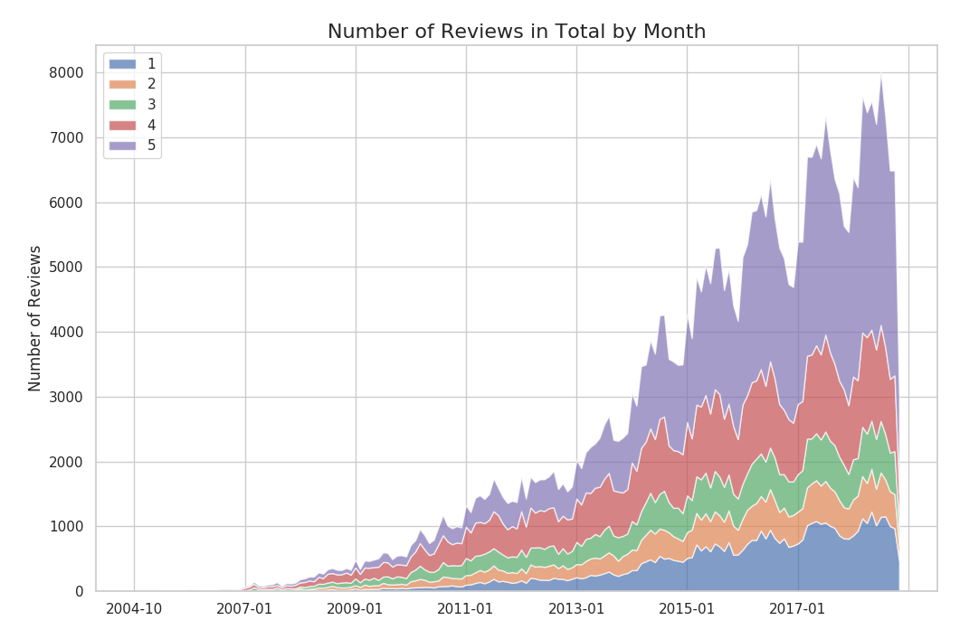
Trend by Season
Summer
Winter

Slide 9
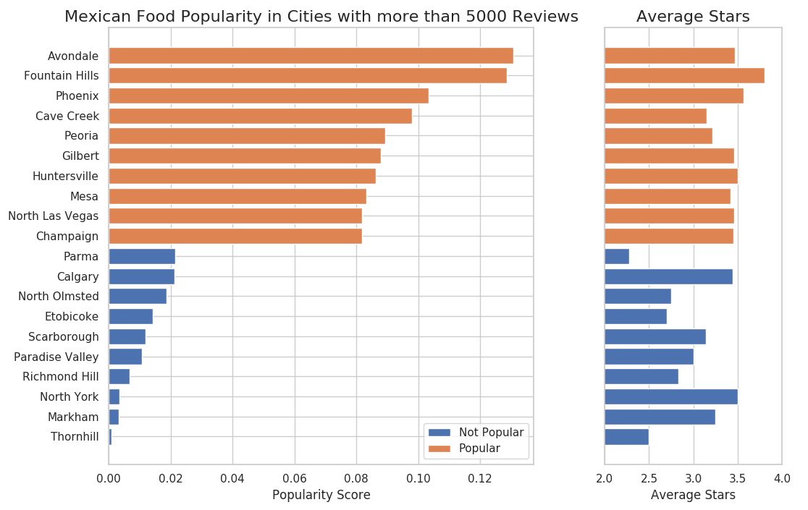
Mexican Food Popularity

Slide 10
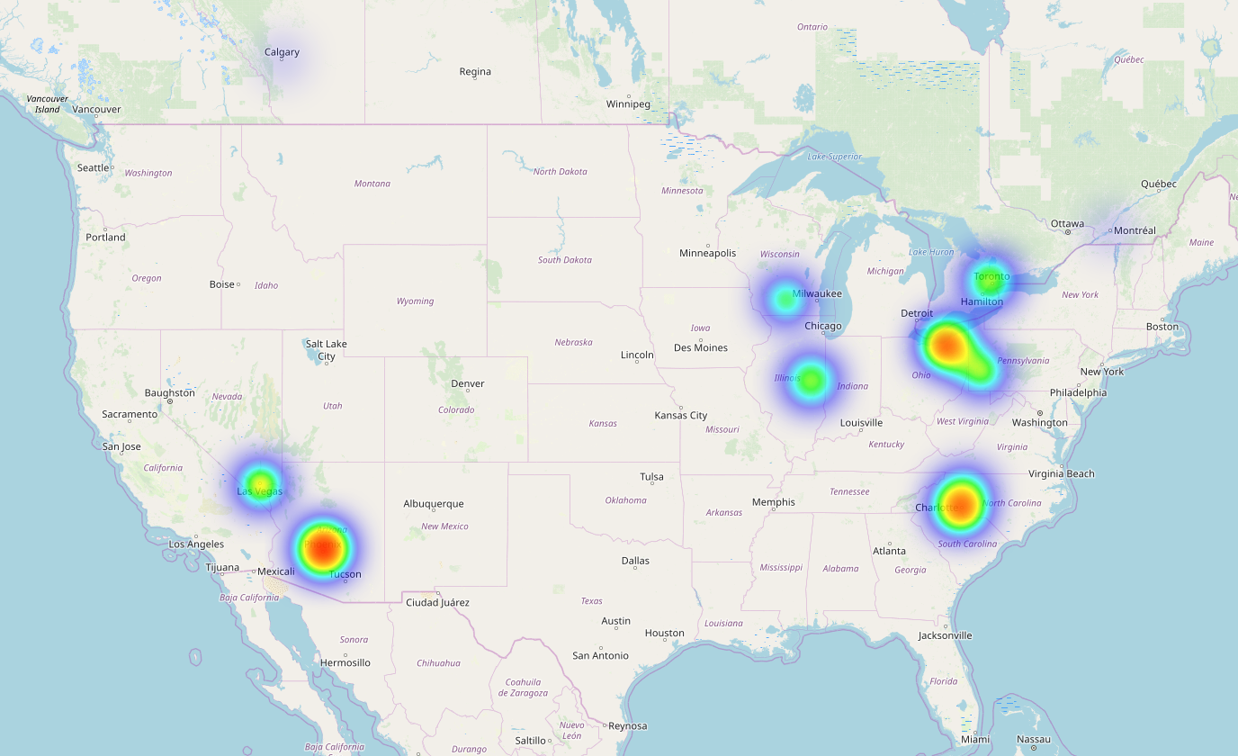
Mexican Food Popularity Heatmap
Toronto
Cleveland
Las Vegas
Phoenix,
Avondale,
Fountian Hill etc.
Charlotte

Slide 11
Population Composition
 | Hispanic or Latino
Phoenix | 40.8%
Las Vegas | 31.5%
Madison | 6.8%

Slide 12
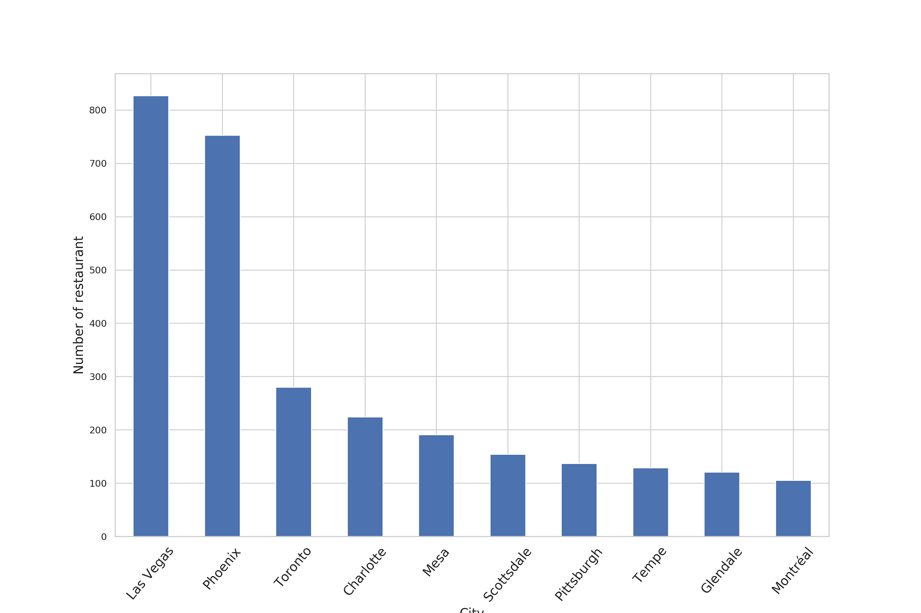
Top 10 cities with LARGEST number of mexican restaurants
Top 3 cities
Las Vegas : 827
Phoenix: 753
Toronto: 280

Slide 13
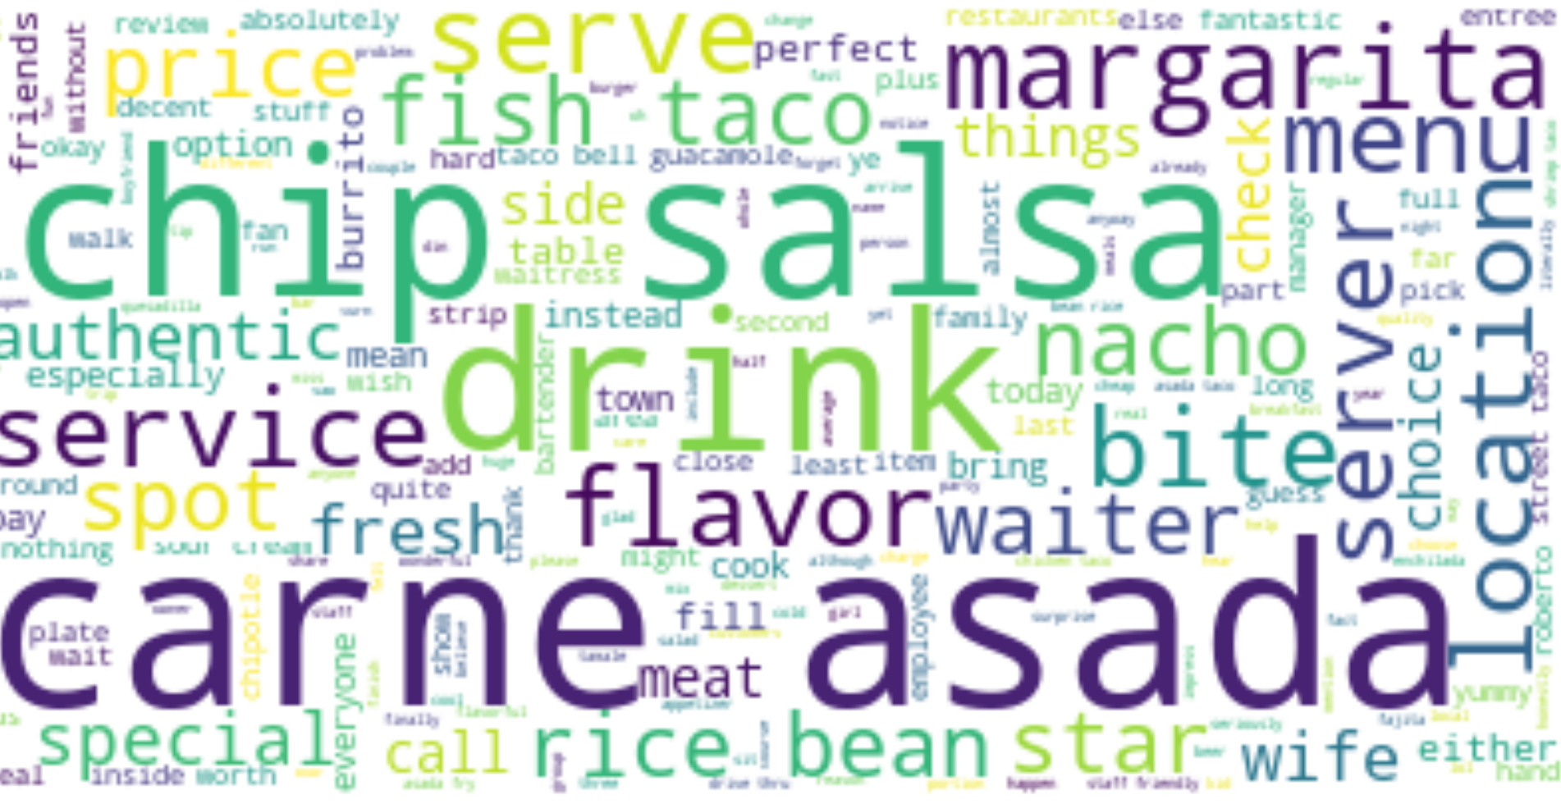
Word cloud of review in Top 3 cities
FOOD:Carne,asada,chip,salsa,bite,
flavor
DRINK:margarita
SERVICE
LOCATION
Top 1: Las Vegas

Slide 14
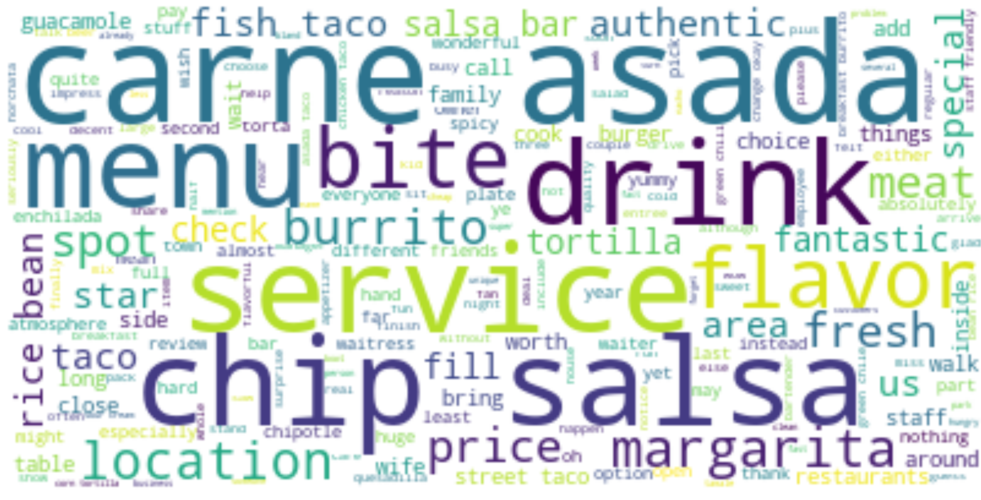
Word cloud of review in Top 3 cities
FOOD:Carne,asada,chip,salsa,bite,
flavor
MENU
DRINK
SERICE
Top 2: Phoenix

Slide 15
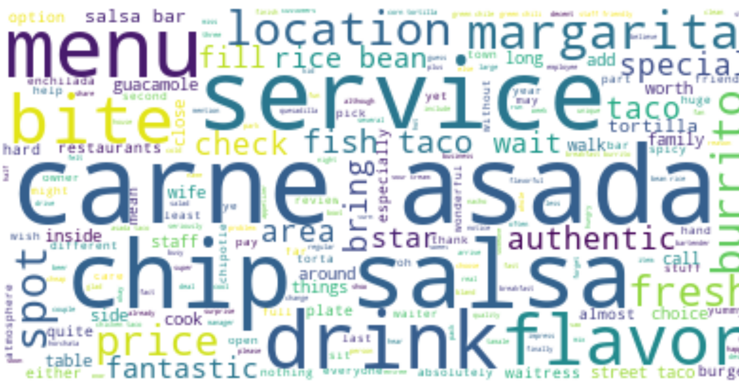
Word cloud of review in Top 3 cities
FOOD:Carne,asada,chip,salsa,flavor
MENU
DRINK
SERICE
Top 3: Toronto

Slide 16
Frequency of Keywords
VS
Star Level
among THREE Cities

Slide 17
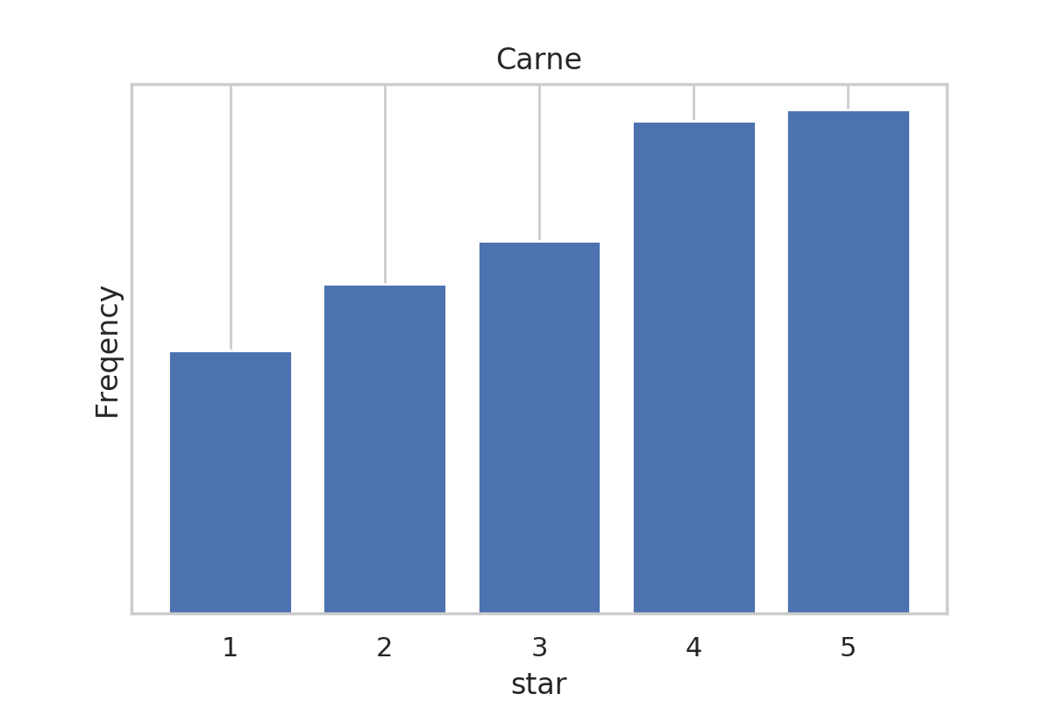
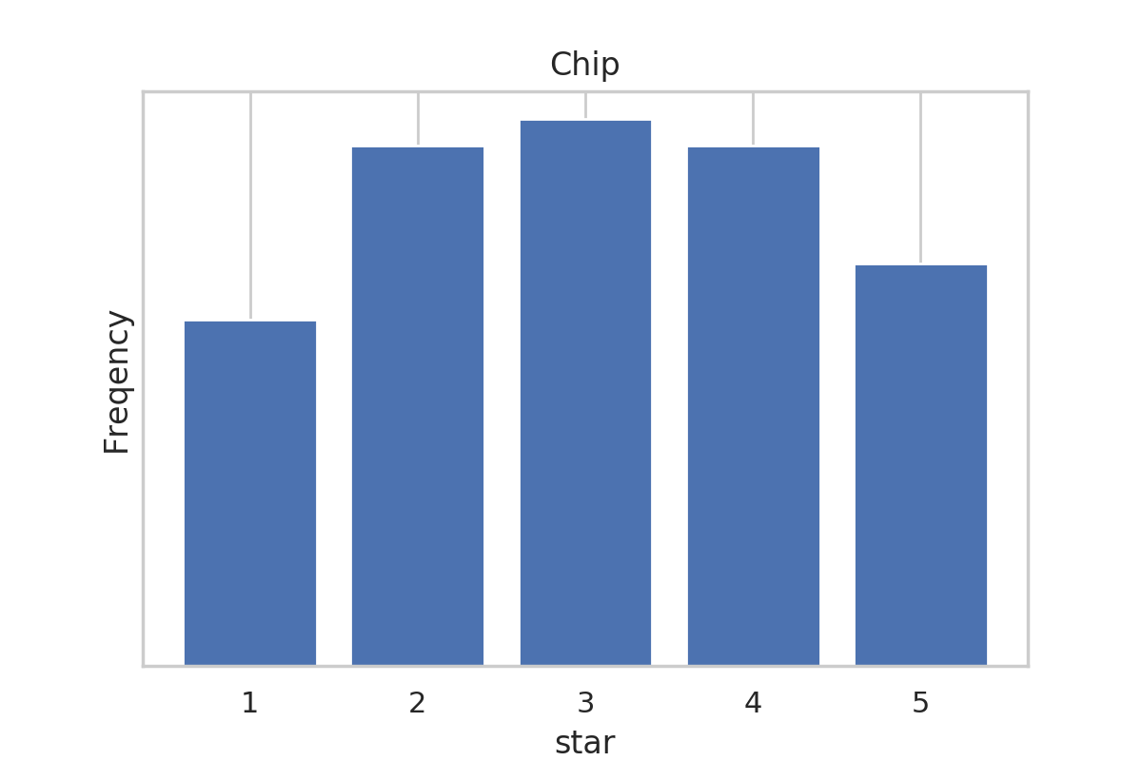
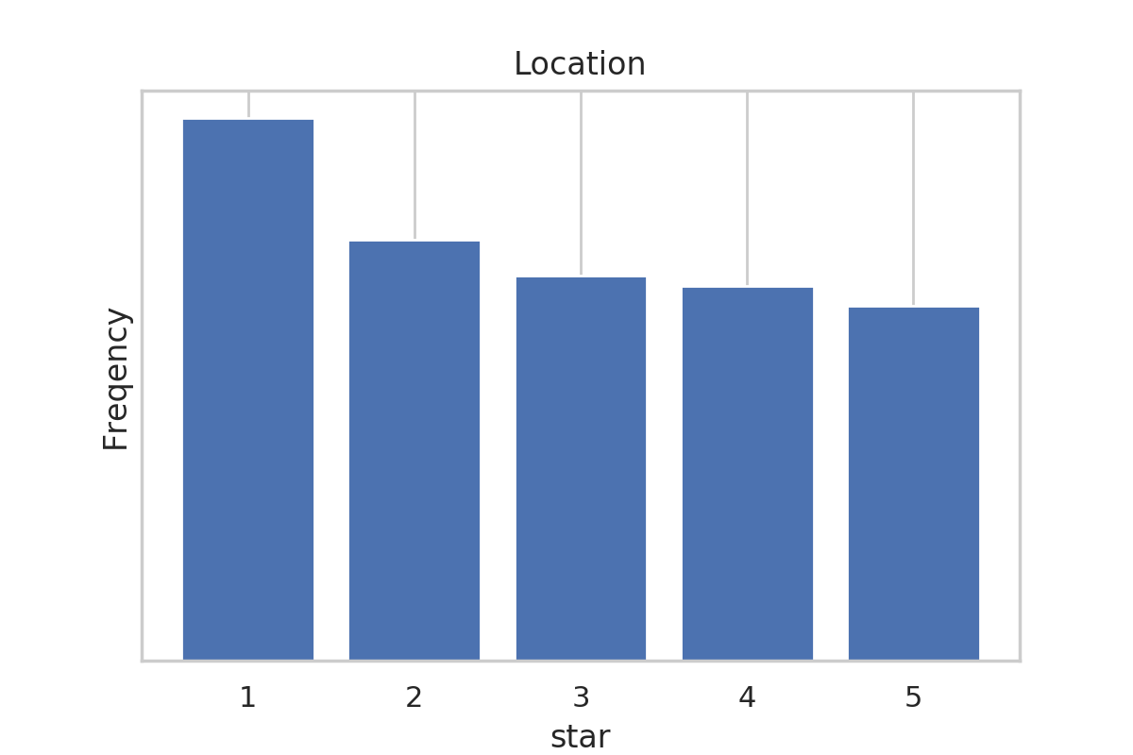
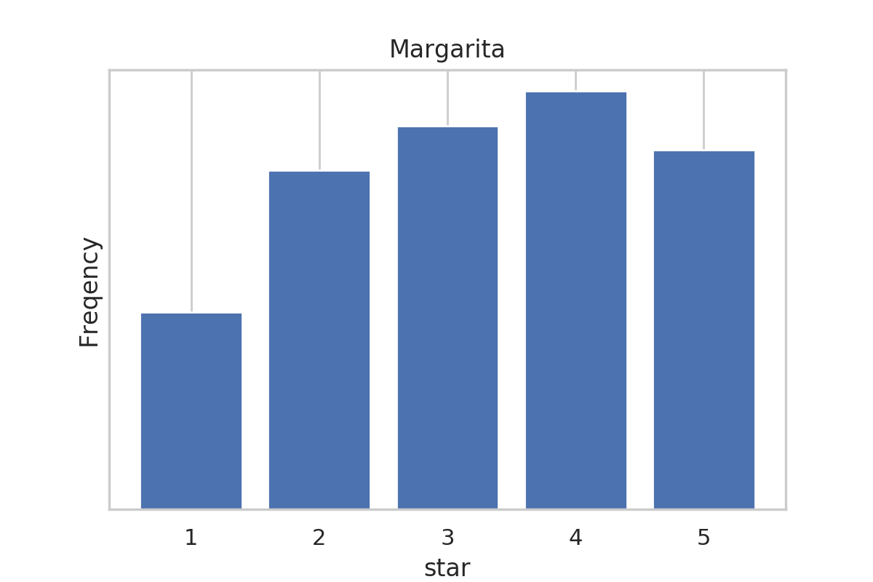
Top 1: Las Vegas

Slide 18
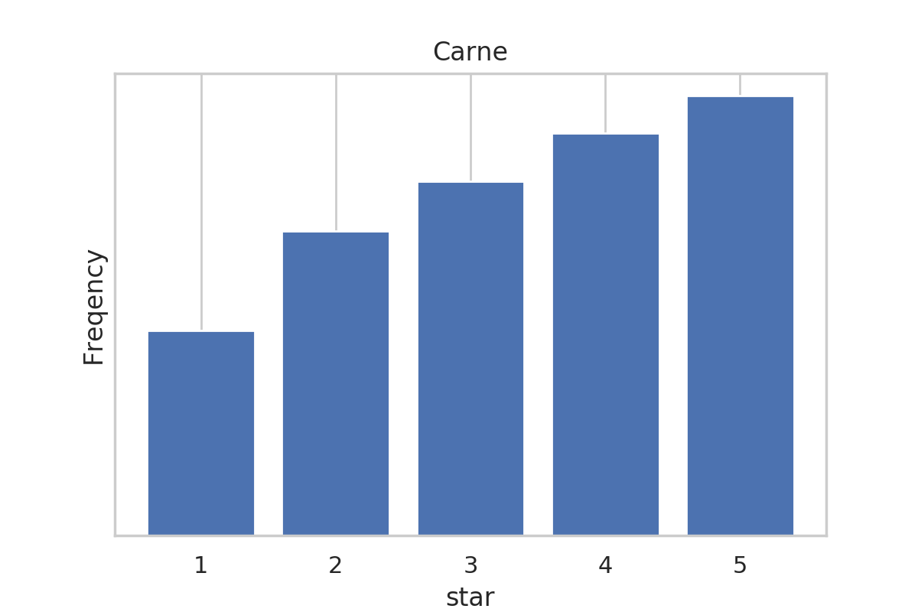
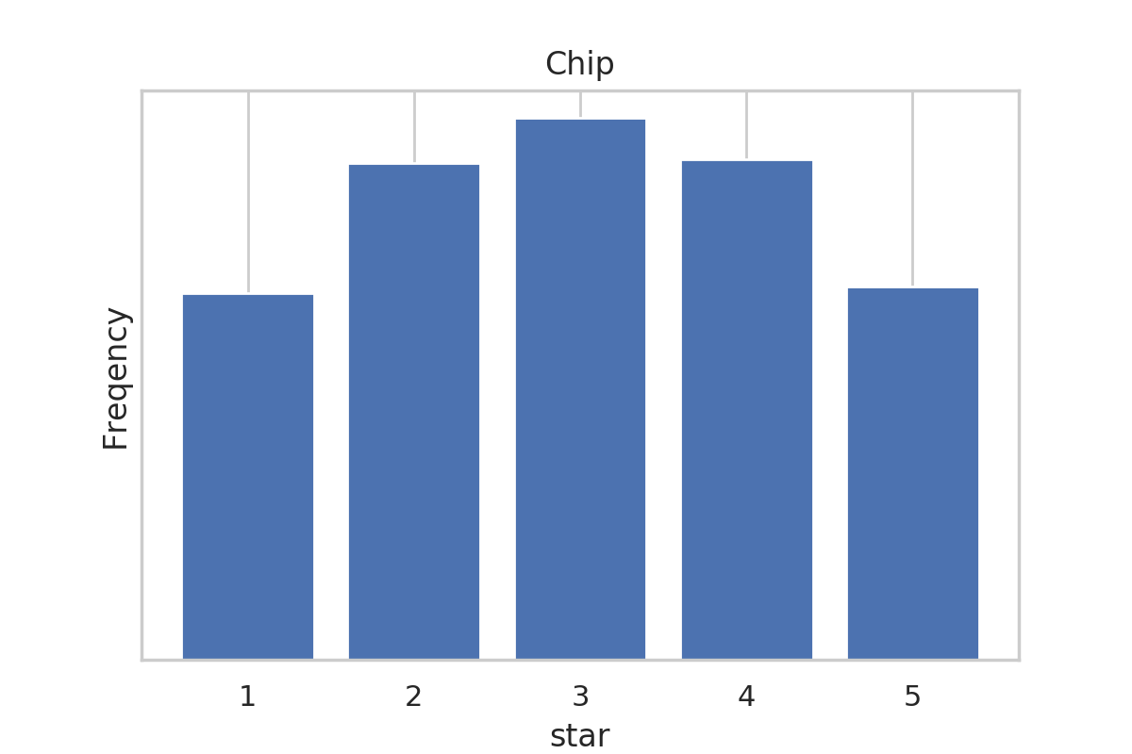
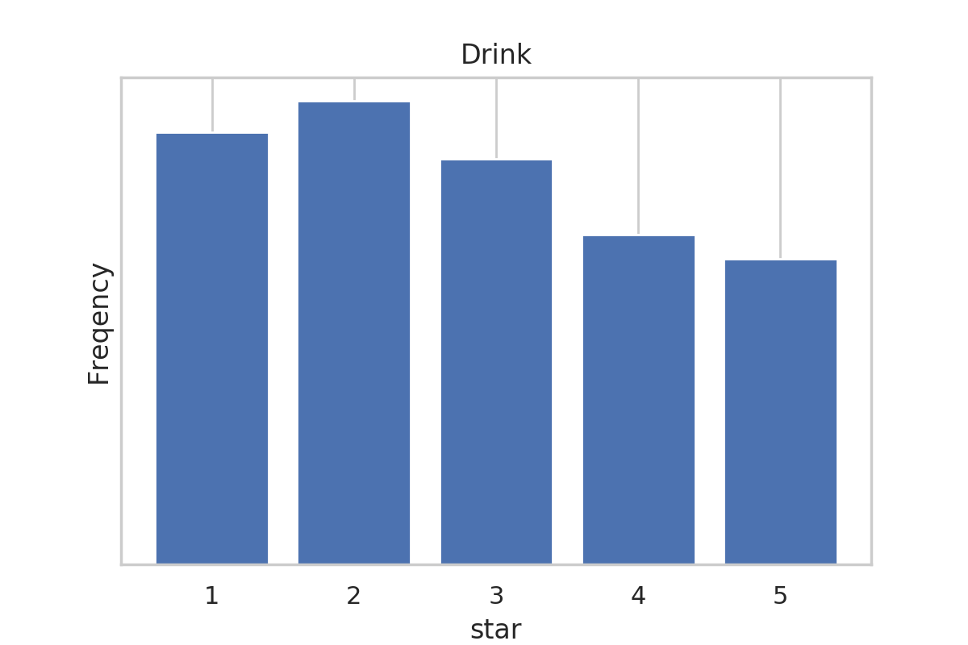
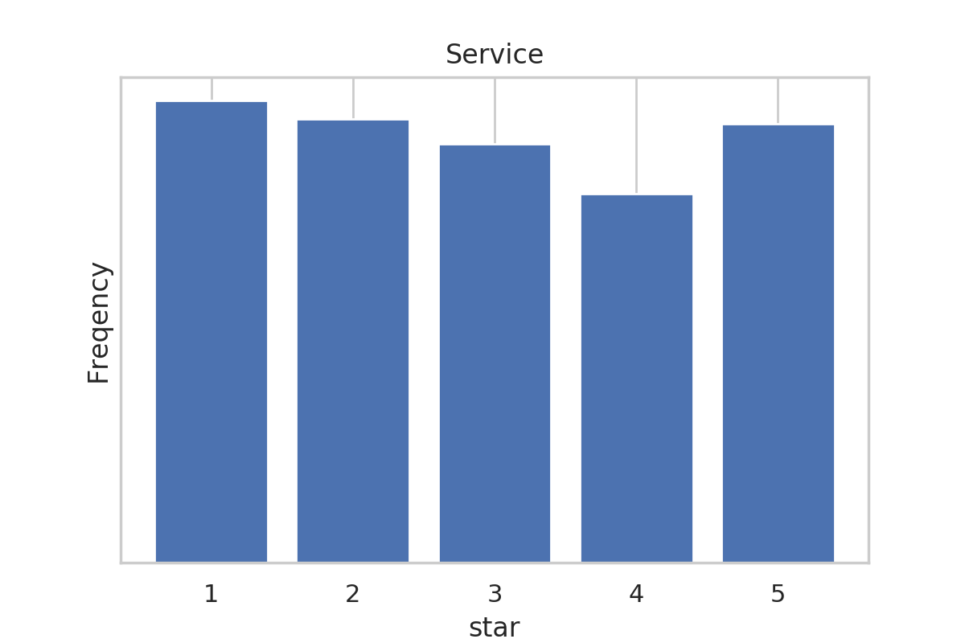
Top 2: Phoenix

Slide 19
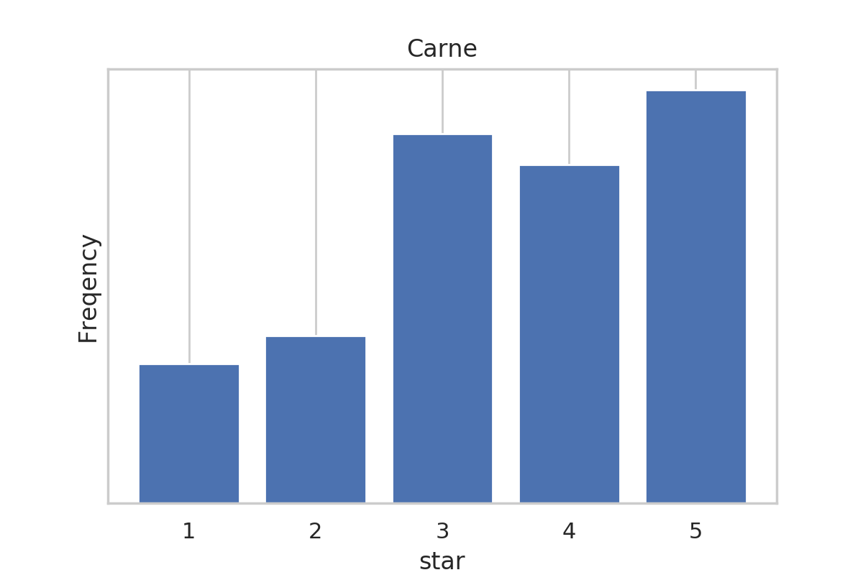
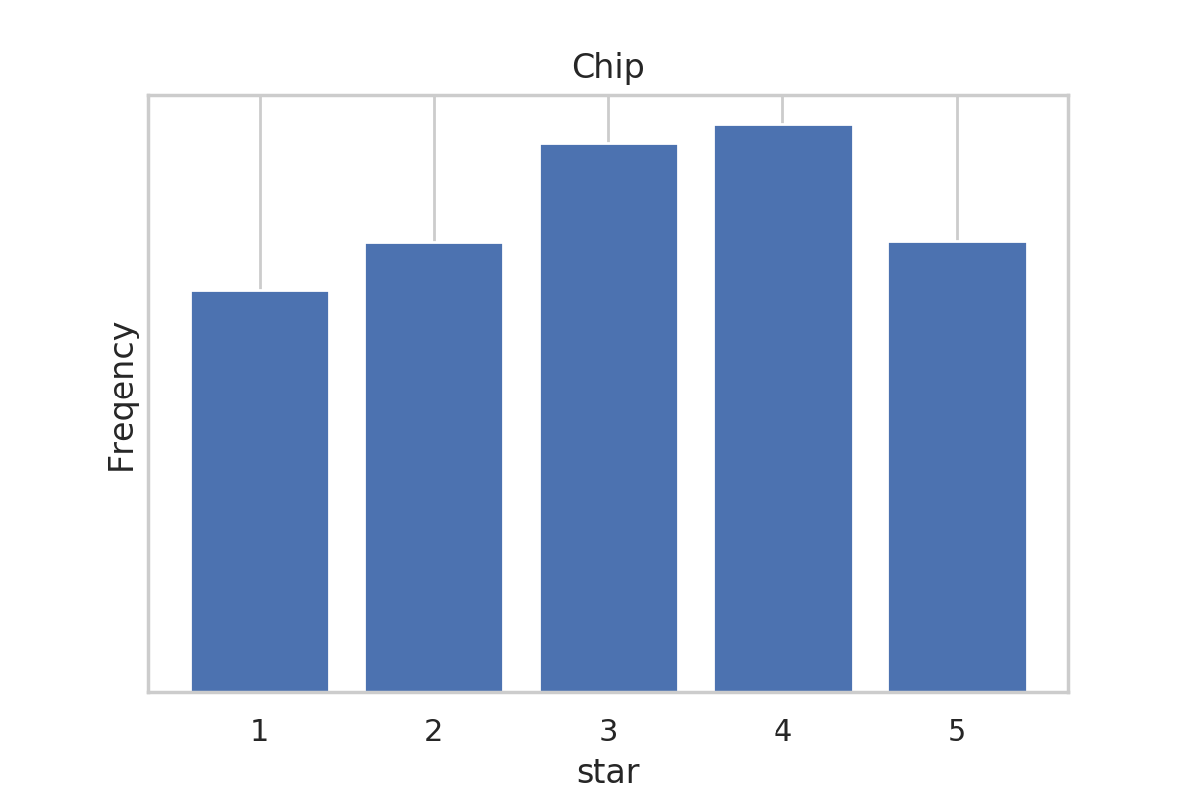
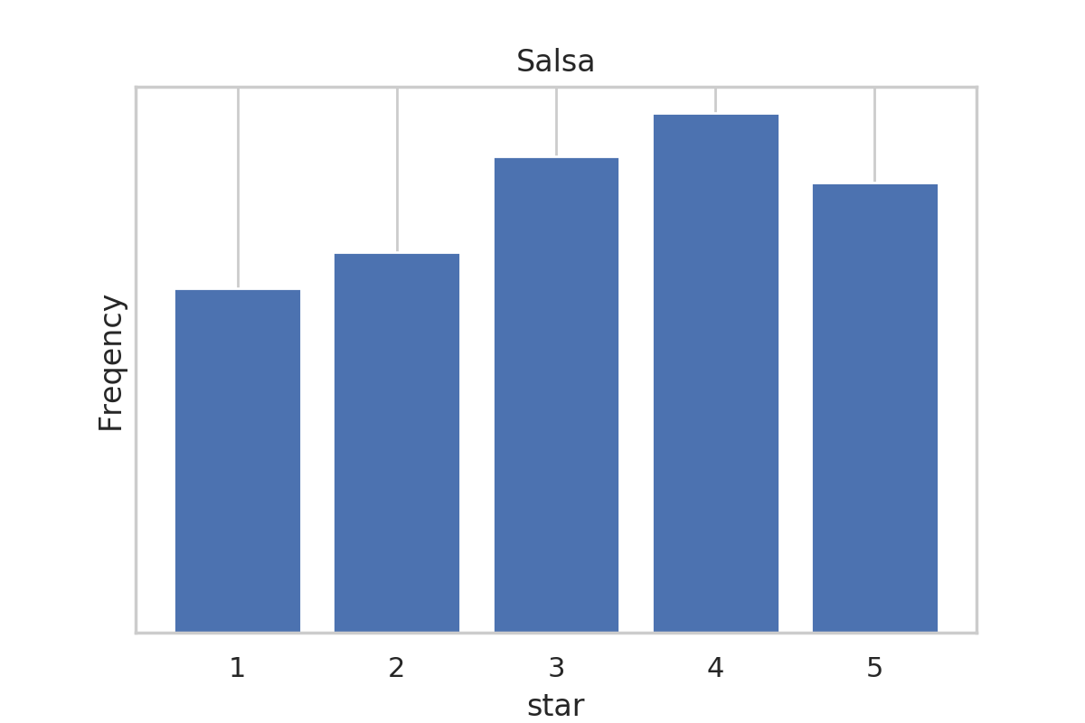
Top 3: Toronto

Slide 20
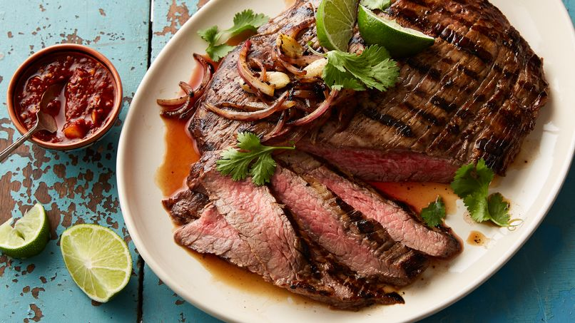
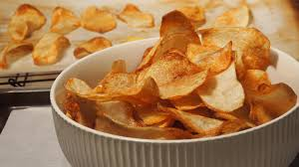
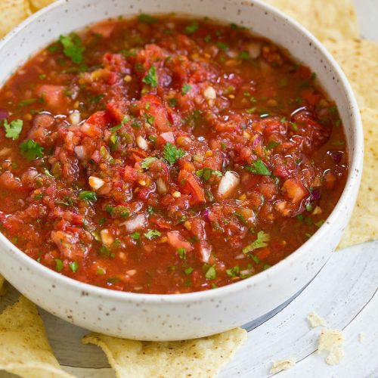
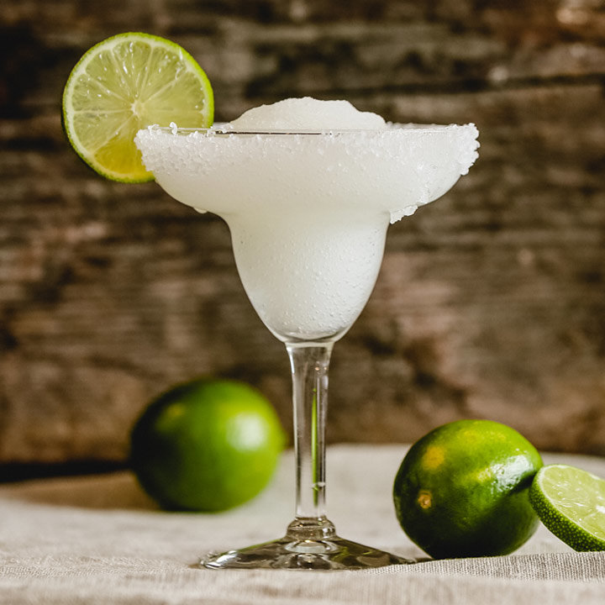

Our Conclusion for Mexican Restaurant in these Cities
margarita
Good Service; Bad Location
Las
Vegas
Great
Just So-so
Great
Good
Just So-so
Phoenix
Difficult to say
Toronto
Great
Just So-so
Good
Difficult to say
Carne Asada
Chip
salsa
Drink
Others

Slide 21
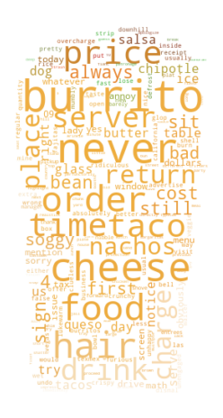
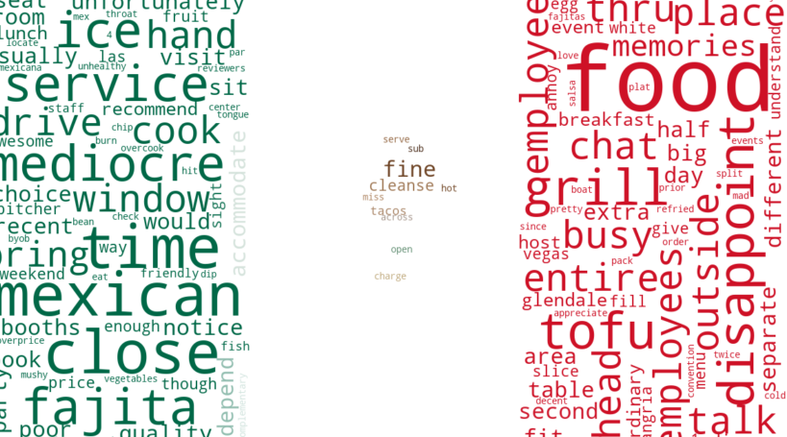
Word cloud of reviews in 5 star levles

Slide 22
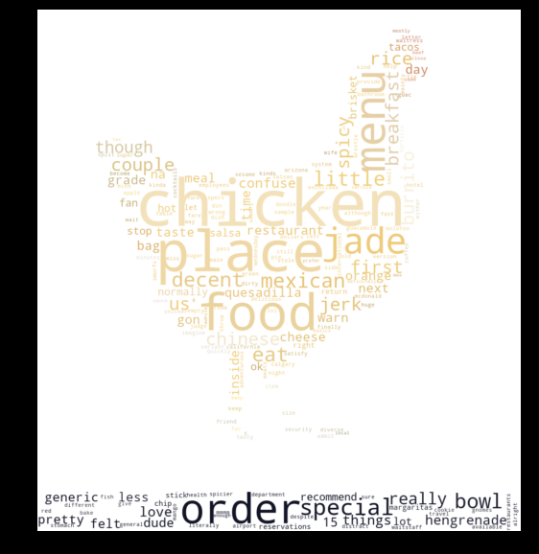
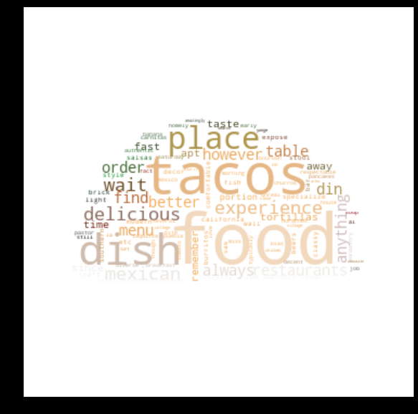
Word cloud of reviews in 5 star levles

Slide 23
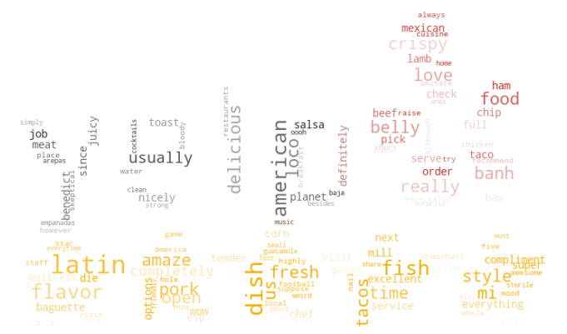
Word cloud of reviews in 5 star levles

Slide 24
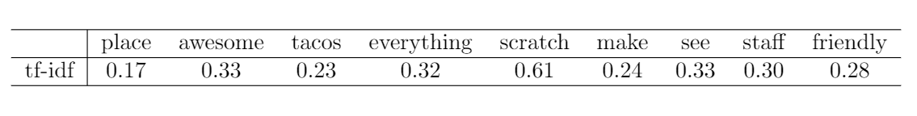
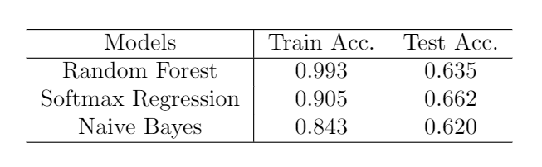
TF-IDF & Simple Classification Models
We randomly selected 30000 reviews from Phoenix.
TF-IDF Example:
Model Performance:

Slide 25
Future WorK
More Work
Information Value of high frequency words.
Ranking changes according to time.
Find Positive and Negative words according to some criterions.
Models
Try different models for star classification.
Use NLP methods to find keywords and their influence on review stars.
Shiny APP
give suggestions in different cities.
give business presences for business owners.
give advice to improve rating in Yelp.

Slide 26
Thank You !

